Slide 1
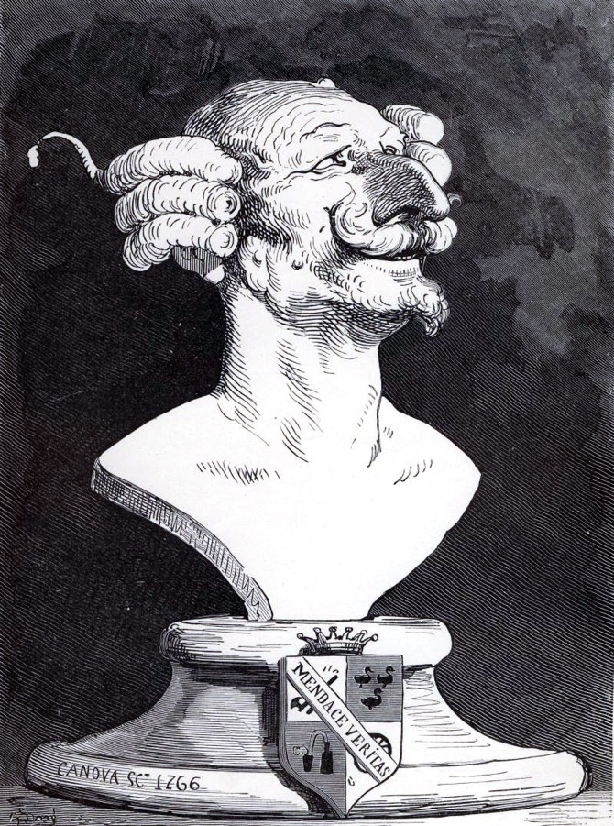
Bootstrapping
Keletso Makofane
PhD Candidate in Social Network Epidemiology
Harvard TH Chan School of Public Health
[draft sep 2020]
keletso.makofane@gmail.com
Twitter: @klts0
Keletso Makofane, DRAFT, September 2020
Notes:
Ever wondered what you’re actually doing when you calculate bootstrap standard errors? Or, where the term bootstrap came from? THREAD! #tweetorial #epitwitter

Slide 2
hair length = 10
hair length = 20
hair length = 30
hair length = 40
Keletso Makofane, DRAFT, September 2020
Notes:
We are interested in estimating hair length in a population. And in this special population, there are only four kinds of people who each have a specific hair length.

Slide 3
...
Keletso Makofane, DRAFT, September 2020
Notes:
There are many, many, members of this population. It is impossible to measure all their hair to calculate the mean hair length. What you decide to do instead, is to take a random sample.

Slide 4
...
Keletso Makofane, DRAFT, September 2020
Notes:
So you pick 6 people at random and accost them with a ruler. (You got IRB for this approach beforehand.)

Slide 5


$${\overline{X}}_{SRS}=\frac{10+10+20+20+30+30+40+40}{8}=2.5$$
$${Var(\overline{X}}_{SRS})= ?$$
Keletso Makofane, DRAFT, September 2020
Notes:
You manage to ascertain their hair length. To estimate the mean hair length for the population, you take an average of the measurements.
You friend, who took a stats class once asks: How can you claim to know the true mean hair length of millions of people, when you only sampled 6?

Slide 6
...
Keletso Makofane, DRAFT, September 2020
Notes:
You decide to take multiple samples and estimate the mean each time. You want to get a sense of how much the estimate changes every time you draw a random sample. Here is one.

Slide 7
...
Keletso Makofane, DRAFT, September 2020
Notes:
And another sample

Slide 8
...
Keletso Makofane, DRAFT, September 2020
Notes:
And yet another.

Slide 9





$${\overline{X}}_{1}=2.5$$
$${\overline{X}}_{2}=2.375$$
$${\overline{X}}_{3}=1.875$$
$${\overline{X}}_{4}=2.875$$
...
$${Var(\overline{X}}_{SRS})= \frac{1}{1000}\sum_{i=1}^{1000}{{{(\overline{X}}_{i}−2.5)}^{2}}$$
Keletso Makofane, DRAFT, September 2020
Notes:
So here are the red, purple, green and yellow samples. For each sample, you estimate the mean hair length in the population by taking an average of the hair length in the sample. You can then estimate the standard error of these estimates (square root of the variance). Here we imagine we took 1000 samples.

Slide 10
Keletso Makofane, DRAFT, September 2020
Notes:
But no one has that kind of money and time. What do you do when you want to get a sense of the variability of your estimator without taking 1000s of samples from the same population?

Slide 11
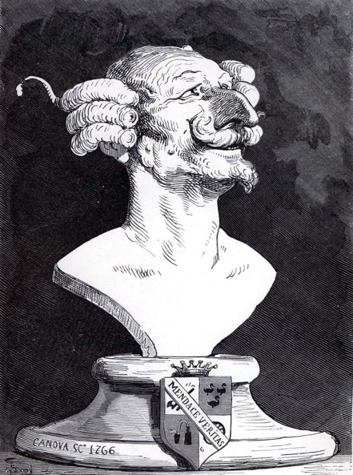
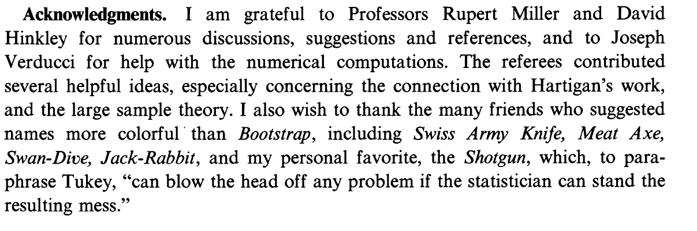
A method named the bootstrap “for reasons which will become obvious”*
Baron Münchhausen's Narrative of his Marvellous Travels, by Rudolf Erich Raspe, was first published anonymously in 1785. One of the many improbable tall tales that its hero tells is of saving himself from drowning in a bog by pulling himself out by his bootstraps (or in some versions, by his hair).
Source: https://en.wikipedia.org/wiki/Baron_Munchausen
Source: https://en.wikipedia.org/wiki/Baron_Munchausen
Efron, B., 1992. Bootstrap methods: another look at the jackknife. In Breakthroughs in statistics (pp. 569-593). Springer, New York, NY.
*Efron, B., 1992. Bootstrap methods: another look at the jackknife. In Breakthroughs in statistics (pp. 569-593). Springer, New York, NY.
Keletso Makofane, DRAFT, September 2020
Notes:
Bradley Effron introduced a useful procedure and named it “bootstrap”. It could have been many other things, but bootstrap is where history landed.

Slide 12

A good sample can stand in for the population
Keletso Makofane, DRAFT, September 2020
Notes:
The central insight was that by taking a sample we have created a snapshot of the population. So if we want to know what it is like to sample repeatedly from the population, we can sample repeatedly from our sample.

Slide 13
Keletso Makofane, DRAFT, September 2020
Notes:
Back to our sample

Slide 14
...
Keletso Makofane, DRAFT, September 2020
Notes:
We imagine that each person in our sample stands in for 1/8th of the population. Here we are imagining the population represented by our sample.
If we take repeated samples (with replacement) from our sample, it is as if we are taking repeated samples from this imagined population. All we need is the red sample to get at the standard error of our estimator.

Slide 15

(a little more) formally
we are interested in characterizing the distribution of $\hat{θ}$, an estimator of $θ$ which is some feature of the probability distribution associated with Cumulative Distribution Function $F$.
we estimate $F$ using our sample data $X=\left\{X_{1}…X_{n}\right\}$ in the following way:
$$\hat{F}\left(x\right)=\frac{\# of cases where X_{i}≤x}{n}$$
we repeatedly draw synthetic samples $X^{∗}=\left\{X_{1}^{∗}…X_{n}^{∗}\right\}$ from $\hat{F}$. Each time we draw a sample $X^{∗}$ we calculate our estimator $\hat{θ^{∗}}$.
if $F≈\hat{F}$ then the distribution of $\hat{θ^{∗}}$will be like the distribution of $\hat{θ}$
Keletso Makofane, DRAFT, September 2020

Slide 16
caution
Keletso Makofane, DRAFT, September 2020
Notes:
THERE IS A CATCH

Slide 17
Keletso Makofane, DRAFT, September 2020
Notes:
We were lucky that the sample we chose (the red sample) to represent the population was exactly like the population.
What if we had chosen the green sample?

Slide 18
Keletso Makofane, DRAFT, September 2020
Notes:
Here is the green sample – what does it imply about the population it came from?

Slide 19
...
Keletso Makofane, DRAFT, September 2020
Notes:
Here is what we would imagine the population looks like, had we used the green sample. It is *very* different from the true population we started with.

Slide 20
...
Keletso Makofane, DRAFT, September 2020
Notes:
Remember: here is what the true population looks like. Very different than what the green sample would lead us to believe.

Slide 21
caution: if the sample does not look like the population, bootstrap inference will be wrong
Keletso Makofane, DRAFT, September 2020
Notes:
Bootstrapping does not help you with sample size problems. You need your sample to be as representative of the population as possible in order to estimate how variable your estimator is.

